Slide 1
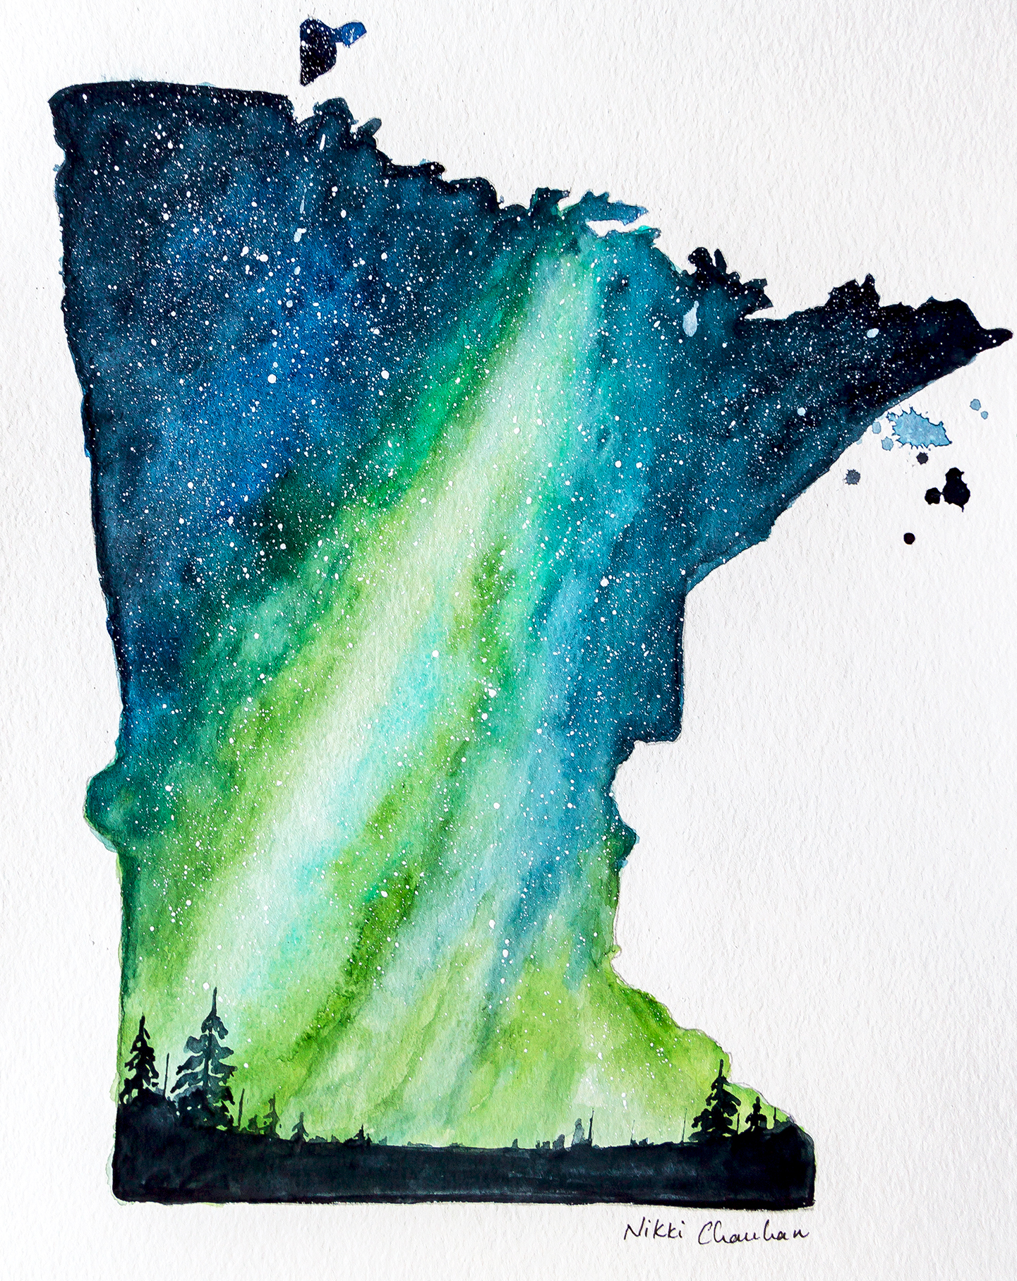
Bridges 2018
Minnesota :
Our Home
Saturday, November 10th, 2018
7:30pm
Roseville Lutheran Church

Slide 2
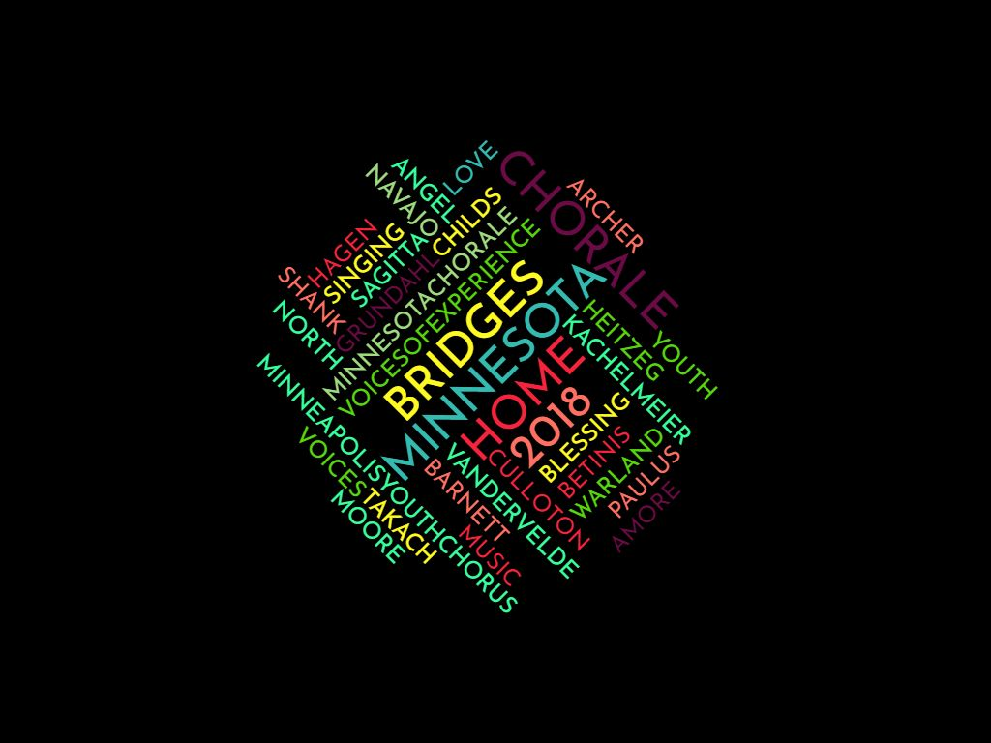

Slide 3
I Started Out Singing
by Jocelyn Hagen

Slide 4
I started out singing
oh yes oh yes
in a voice as clear
as a penny and a dime

Slide 5
In time, in time
I came to be
as tall as a riddle
as full as a shadow
as far as the wind
that blows itself
alone to the sea

Slide 6
I started out smiling
oh yes oh yes
with my face tipped up
to the moon’s soft stare

Slide 7
a halo of giggles
tied in my hair
with a sleep as deep
as desert sand
my dreams were the stories that crossed
the land

Slide 8
I started out singing!

Slide 9
Love is Love is Love
by Abbie Betinis

Slide 10
About the work by composer, Abbie Betinis:
"This song is dedicated to the victims, and survivors, of hate crimes everywhere, and specifically for those at the Pulse nightclub in Orlando on June 12, 2016. Love is often the bravest thing we do. May love prevail."

Slide 11
Love is love is love
All we need is love.
Ubi caritas et amor
=
where there is charity and love

Slide 12
Home on the Range
arranged by Timothy C. Takach

Slide 13
Give me a home where the buffalo roam, where the deer and the antelope play.
Where seldom is heard a discouraging word and the skies are not cloudy all day.
Home, home on the range

Slide 14
How often at night when the heavens are bright with the light of the glittering stars,
have I stood here amazed and asked as I gazed if their glory exceeds that of ours.

Slide 15
Then I would not exchange my home on the range, where the deer and the antelope play;
Where seldom is heard a discouraging word and the skies are not cloudy all day.

Slide 16
The Lobster Quadrille
by Matthew Culloton

Slide 17
"Will you walk a little faster?" said a whiting to a snail,
"There's a porpoise close behind us,
and he's treading on my tail.
See how eagerly the lobsters and turtles all advance!
They are waiting on a shingle;
will you come and join the dance?"

Slide 18
"Will you, won't you, will you,
won't you, won't you join the dance?"
"You can really have no notion of how delightful it will be when they take us up and throw us,
with the lobsters out to sea!"

Slide 19
But the snail replied,
"Too far! Too far!"
and gave a look askance,
said he thanked the whiting kindly,
but he would not join the dance.

Slide 20
Would not, could not, would not,
could not, would not join the dance.

Slide 21
"What matters it how far we go?"
his scaly friend replied.
There is another shore you know,
upon the other side.
The further off from England,
the nearer is to France.

Slide 22
Then turn not pale, beloved snail,
But come and join the dance!
"Will you, won't you, will you,
won't you, won't you join the dance?
Oh, join the dance!"

Slide 23
O, Colored Earth
by Steve Heitzeg

Slide 24
Black white red brown yellow birth,
Blue and green, o colored earth
Sister Rain, Brother Stone,
Bring us back to our true home.

Slide 25
What can I, a single soul,
Do for those I don't even know?
O, I shall sing, and I shall work
for peace on earth until all are free.

Slide 26
Peace and love, love and peace,
the earth is waiting.
help one another
the earth is waiting
Peace and love

Slide 27
No more war. No more fear.
May hunger soon disappear.
No more doubt, no more lies.
Only truth shall free the cries.

Slide 28
Only hope, only dreams
can erase the tears and screams.
O, I shall sing and I shall work
for peace on earth until all are free.

Slide 29
Sing Creations Music On
By Stephen Paulus

Slide 30
Sing creations music on.

Slide 31
Nature's glee is in every mood and on eternity.
Nature's universal tongue.
Sing and hear.

Slide 32
Songs I've heard and felt and seen everywhere!
Songs like the grass are evergreen everywhere!

Slide 33
The giver said live and be and they had faith forever!
Songs I've heard and felt everywhere.
Sing creations music on.

Slide 34
Nature's glee is in every mood and on.
Songs I've heard and felt and seen everywhere.
Sing creations music on.

Slide 35
Sagitta
by Mary Ellen Childs
Alyssa Northrop & Molly Maillette, dancers

Slide 36
To See the Sky
By Jocelyn Hagen

Slide 37
One by one,
like leaves from a tree,
All my faiths have forsaken me;

Slide 38
But the stars above my head burn in white and
delicate red,

Slide 39
And beneath my feet the earth brings the sturdy grass to birth.

Slide 40
I who was content to be but a silken-singing tree, but a rustle of delight in the wistful heart of night,

Slide 41
I have lost the leaves that knew the touch of rain and weight of dew.

Slide 42
Blinded by a leafy crown
I looked neither up nor down
but the little leaves that die have left me room to see the sky;

Slide 43
Now for the first time I know stars above and earth below.
- Sara Teasdale, from "Leaves"

Slide 44
The Dot's Hocket
From Adventures of the Black Dot
by Janika Vandervelde

Slide 45
Narrator: Alyssa Breece
Accordian: Tony Zuchora-Walske

Slide 46
Minnesota, That's Me
by Carol Barnett

Slide 47
Whether I was born here or crossed the land and sea to shout out my name in a country wide and free,

Slide 48
In woods and glassy cities, across prairieland I roam, Minnesota is my home.

Slide 49
Where Ole and Lena meet White Elk and Migina,
Meet Jose and Martina,
Meet Hakim and Adina,
Minnesota, you see?
Minnesota, that's me!

Slide 50
Pull a chair up to the table,
I'll fill you up a plate,
I got hotdish, got papaya,
I got fry bread. No wait!
You want chile relleno?
Stew of goat or wild rice?
Come, sit close,
I'll show you Minnesota nice.

Slide 51
Where Ole and Lena meet meet Hakim and Adina,
meet Ismail and Amina, meet Jose and Martina,
meet White Elk and Migina, meet See Sing and Yong Yee,
Minnesota, you see?
Minnesota, that's me!

Slide 52
I got ten thousand lakes,
Ninety-thousand
miles of shore.
The world's biggest
ball of string.
Got slate and iron ore.
I grow oats and corn
and soybeans.
I got Post-It notes galore.
You can have some
for a small fee.
Minnesota, that's me!

Slide 53
Where Ole and Lena meet White Elk and Migina,
meet Hakim and Adina, meet Jose and Martina,
meet Ismail and Amina, meet See Sing and Yong Yee,
Minnesota, you see?
Minnesota, that's me!

Slide 54
We know floods, we know droughts, we know tornadoes, and once we get 'em planted we gotta dig potatoes.
Below zero,
the wind chills freeze.
And some of us get sick on milk and cheese.
Still...

Slide 55
Whether we were born here or crossed the land and sea
we shout out our names in a country wide and free,
in woods and glassy cities,
across prairieland we roam,
Minnesota our home.

Slide 56
Where Ole and Lena meet White Elk and Migina,
meet Hakim and Adina, meet Jose and Martina,
meet Ismail and Amina, meet See Sing and Yong Yee,
Minnesota, you see?

Slide 58
North Star Song
music by Ryland Angel and Malcolm Archer
words by Michael Dennis Brown

Slide 67
Kitty Goggins
Board President

Slide 71
Everyone Sang
by Linda Kachelmeier

Slide 72
Ev'ryone suddenly burst out singing;
and I was filled with such delight

Slide 73
As prisoned birds must find in freedom, winging wildly across the white orchards and dark green fields;
on, on, and out of sight.

Slide 74
Everyone's voice was suddenly lifted;
and beauty came like the setting sun:

Slide 75
My heart was shaken with tears; and horror
Drifted away...

Slide 76
O, but Everyone was a bird;
and the song was wordless;
the singing will never be done.

Slide 77
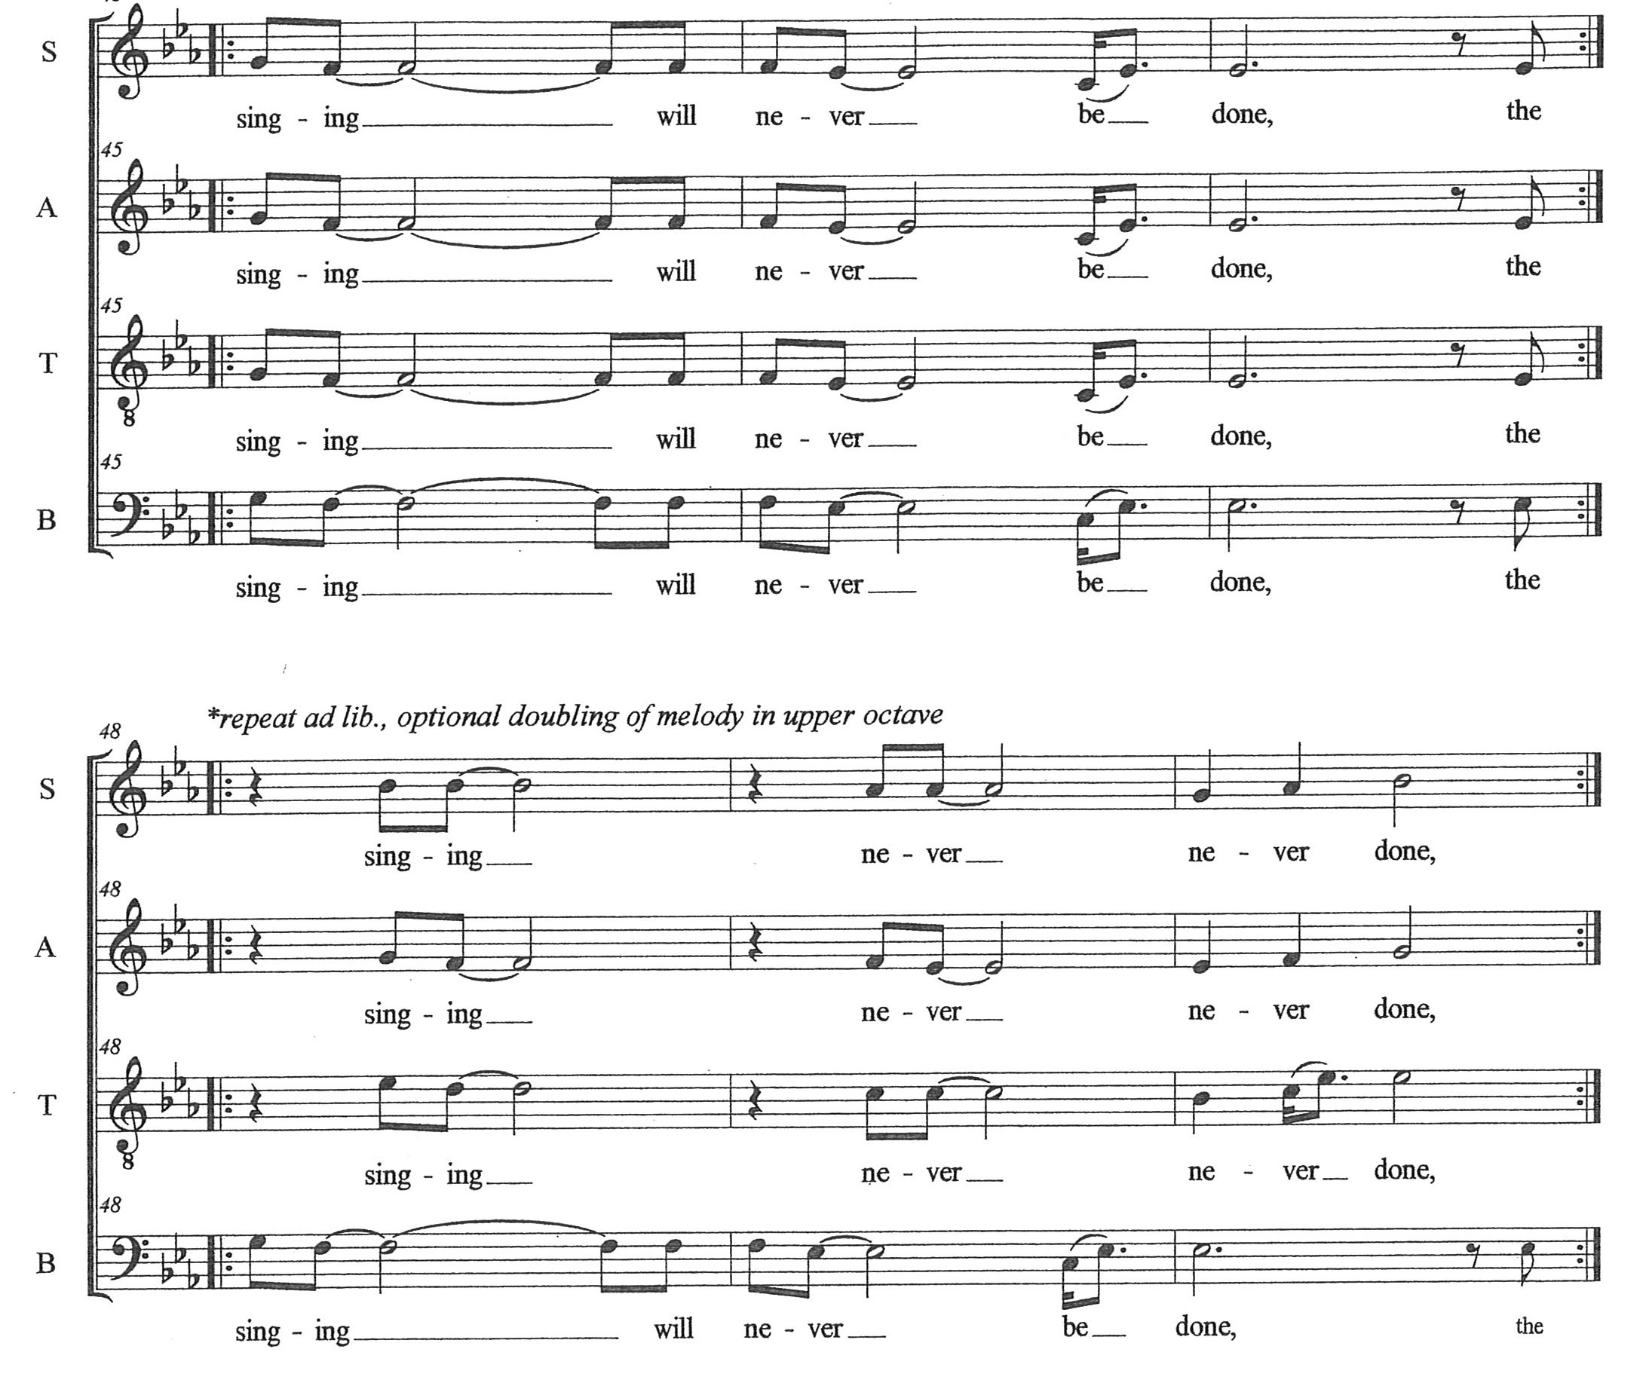

Slide 78
The Road Home
by Stephen Paulus
solo: Mary Seidlitz

Slide 79
Tell me where is the road I can call my own,
That I left,
that I lost,
So long ago?

Slide 80
All these years I have wandered,
Oh when will I know there's a way,
there's a road that will lead me home?

Slide 81
After wind, after rain, when the dark is done, as I wake from a dream in the gold of day,
through the air there's a calling from far away,
there's a voice I can hear that will lead me home.

Slide 82
Rise up, follow me, come away is the call,
with love in your heart as the only song;
there is no such beauty as where you belong,

Slide 83
Rise up, follow me, I will lead you home.

Slide 84
O, Be Swift to Love
by Nancy Grundahl

Slide 85
Oh, be swift to love and make haste to be kind.
Love and be kind.

Slide 86
Sed Amore
by Dale Warland

Slide 87
Hearts, therefore, are won not by arms,
but by love and greatness of soul.

Slide 88
Above all, it is useful for people
to establish relationships,
to bind themselves by those bonds,

Slide 89
which are most apt to unite them as one;
and without exception,
to do those things which serve to
strengthen friendship.

Slide 90
Hearts, therefore, are won not by arms,
but by love and greatness of soul.
- Benedict de Spinoza (1632-1677)

Slide 91
me(n)
by Joshua Shank

Slide 92
I know that I am greater...
...than how others may see me
...than the challenges I may have to face
...than all the ways that people can hate
...than the person they say I should be
...than the numbers that may define me
...than the expectations of being a man

Slide 93
I know that I am greater...
...than how people see the color of my skin
...than what people think of who I love
...than the stresses in my life
...than the pressures coming from my parents
...than what my teachers may think of me
...than what I may think of myself
...than the boy you think you know

Slide 94
I know that I am greater...
...than my worst few moments
...than the things in life I cannot change
...than the limitations I place on myself

Slide 95
I know that I am greater when I try to understand
That I'm on my own,
But I'm not alone
If I try to lend a hand.

Slide 96
I know that I am greater if I never, ever lie.
To be upright
And “win the good fight,”
Can always be my battle cry.

Slide 97
And I may not agree about you and me
But it's never too late
To be a little kinder,
A living reminder that
love will always conquer hate.

Slide 98
I know.

Slide 99
Navajo Blessing
by J. David Moore
Jennifer Slivinski, flute

Slide 100
Beauty goes before me,
Beauty goes beside me,
Beauty follows me.

Slide 101
Everything Sings
by Timothy Takach

Slide 102
How many songs for us to sing?
How many more have we stored away?
Like jars of honey
catching the light,
the sweetness
of time and bees,
of sun and trees,
of you and of me.

Slide 103
It is the wind that taught us to sing
like the prairie grasses,
like the tumbling seas.
It carries our voices;
powerful, beauty
carries them like the scent of rain,
like the falling leaves.

Slide 104
Everything sings;
crickets and clouds, rake and leaves
water and a spoon
even the moon
and the dragonflies
hum their own tune.

Slide 105
My song is my blood
It moves through my body.
My song is my blood
it moves through yours too.
Always finding its way back to the heart,
back to the heart of me and of you.

Slide 107
Bridges 2018
Minnesota :
Our Home
Thank you for attending!

